Slide 1

Project Showcase
Michael Bitenieks
Looker Studio Dashboards
Main Analysis Types
Retention, Cohorts & Churn
A/B Tests & Funnels
CLV, Customer Segmentation & RFM
Situation Based
Projects
Product Analysis
Payments/Monetization Analysis
Marketing Analysis

Slide 2
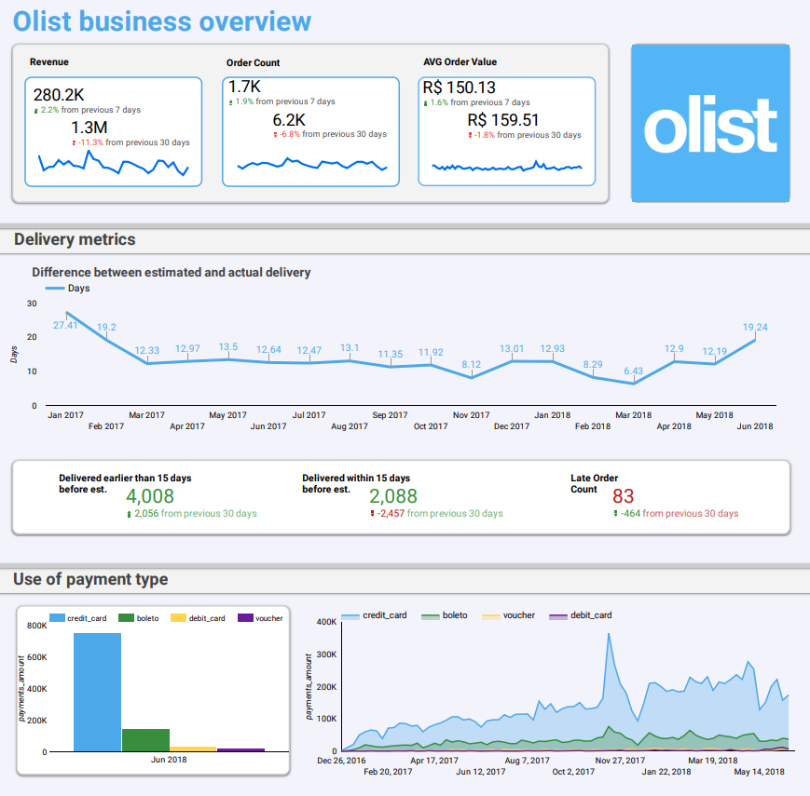
Looker Studio Dashboard
Project purpose was to get acquainted with Looker Studio and the possibilities the tool offers. Task was to improve upon already existing dashboard.
Click here to access the project
Dashboard used as basis

Slide 3
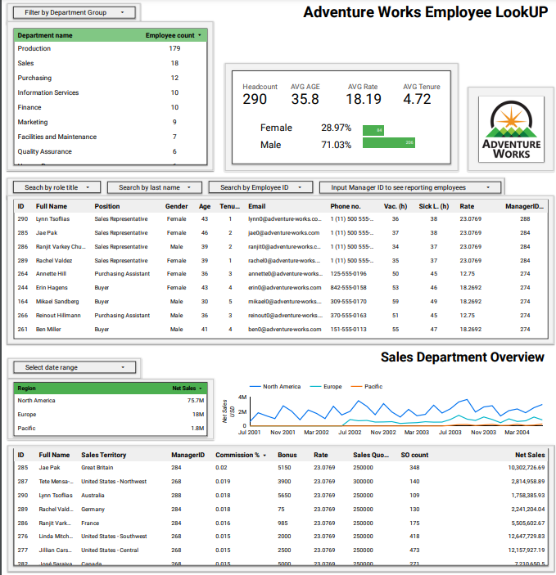
Looker Studio Dashboard
Click here to access the project

Slide 4
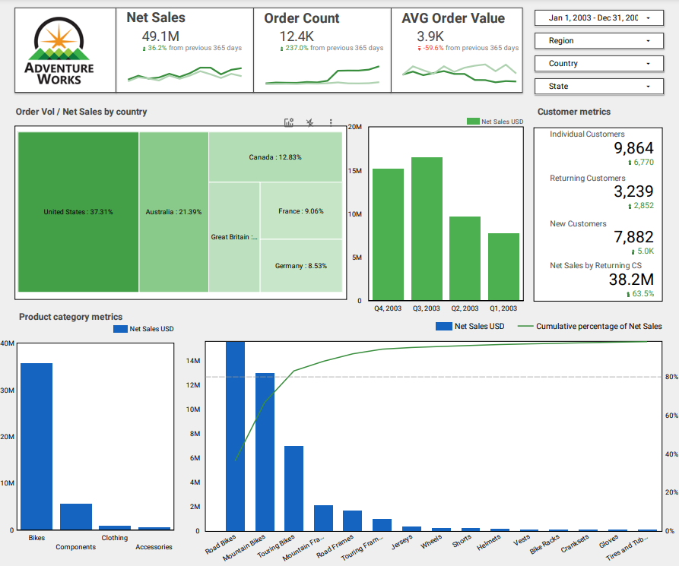
Looker Studio Dashboard
Click here to access the project

Slide 5
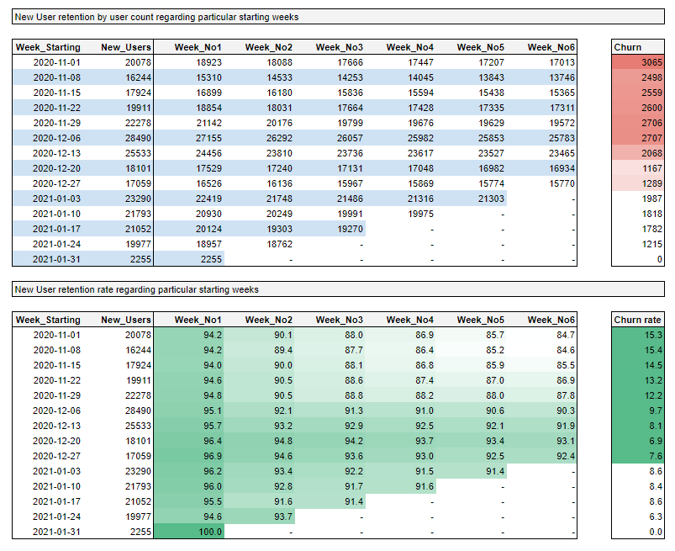
Main Analysis
Types
Retention, Cohorts & Churn
Task: Provide weekly subscriptions data that would show how many subscribers who started on a particular week remain active in the upcoming 6 weeks.
Click here to access the project

Slide 6
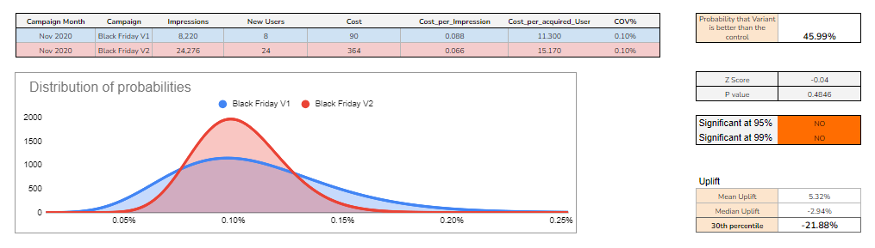
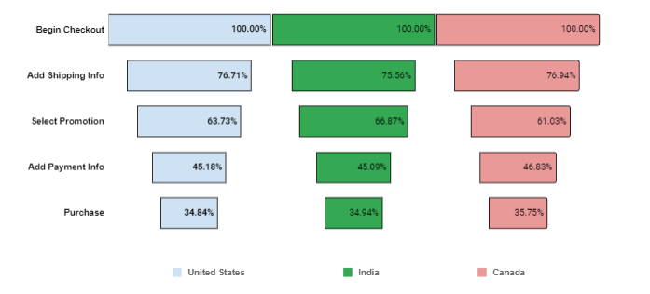
Main Analysis
Types
A/B Tests & Funnels
Task:
Perform A/B Test in order to distinguish performance of marketing campaigns. Create user journey funnel by extracting information from website event data.
Click here to access the project

Slide 7
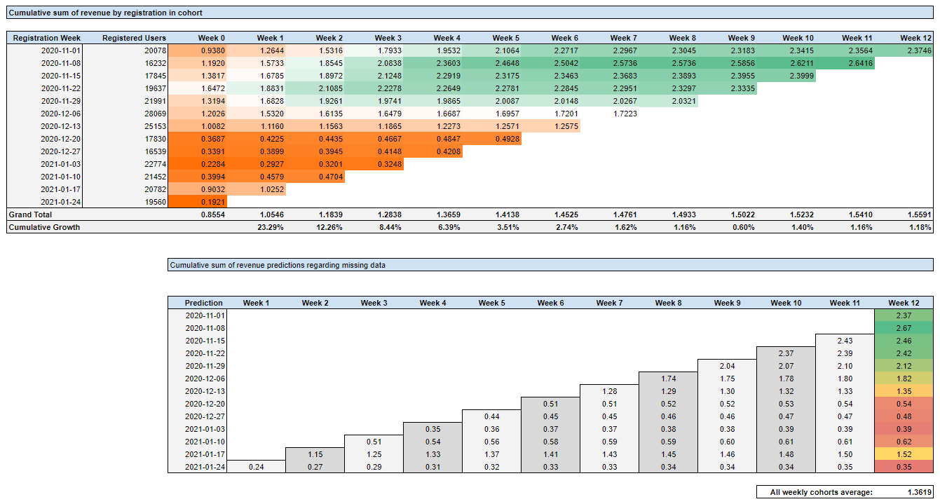
Main Analysis
Types
CLV, Customer Segmentation & RFM
Task:
Segment customers regarding their purchase activity and calculate CLV depending on registration week using SQL.
Click here to access the project

Slide 8
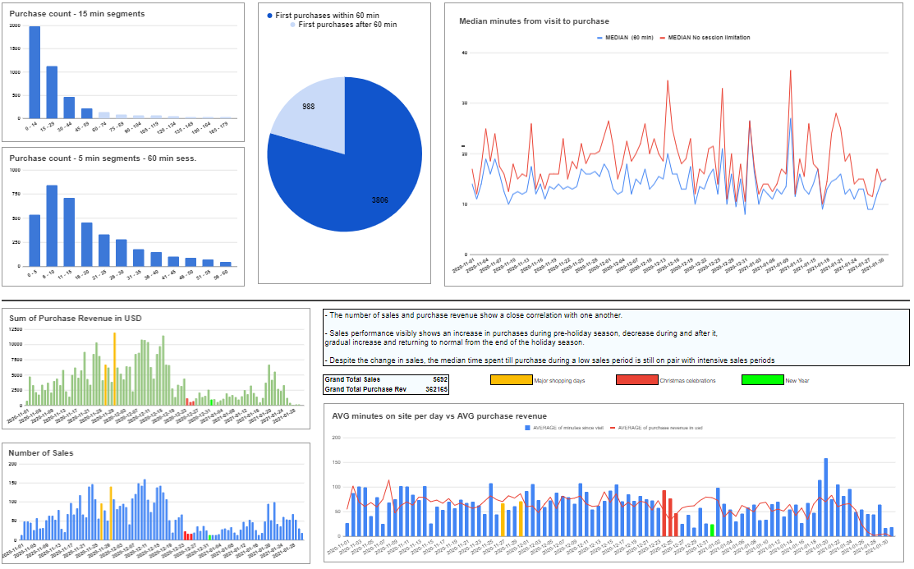
Situation Based Projects
Product Analysis
Task:
Identify how much time it takes for a user to make a purchase on website. Users' duration from first arriving on the website on any given day until their first purchase on that same day.
Click here to access the project

Slide 9
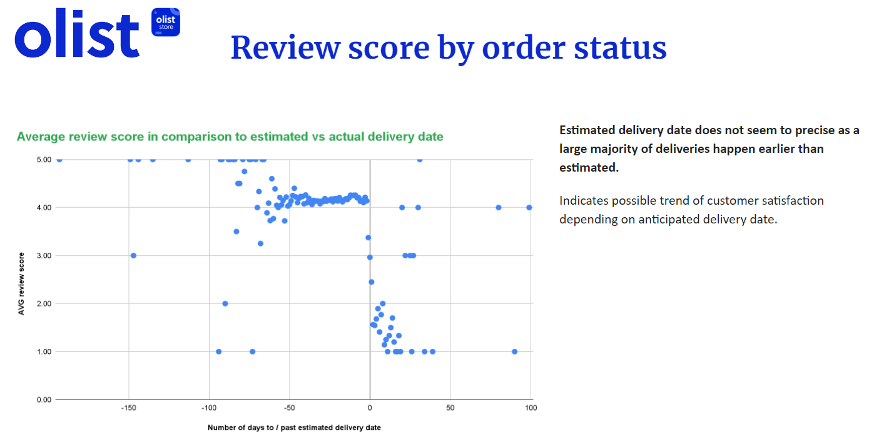
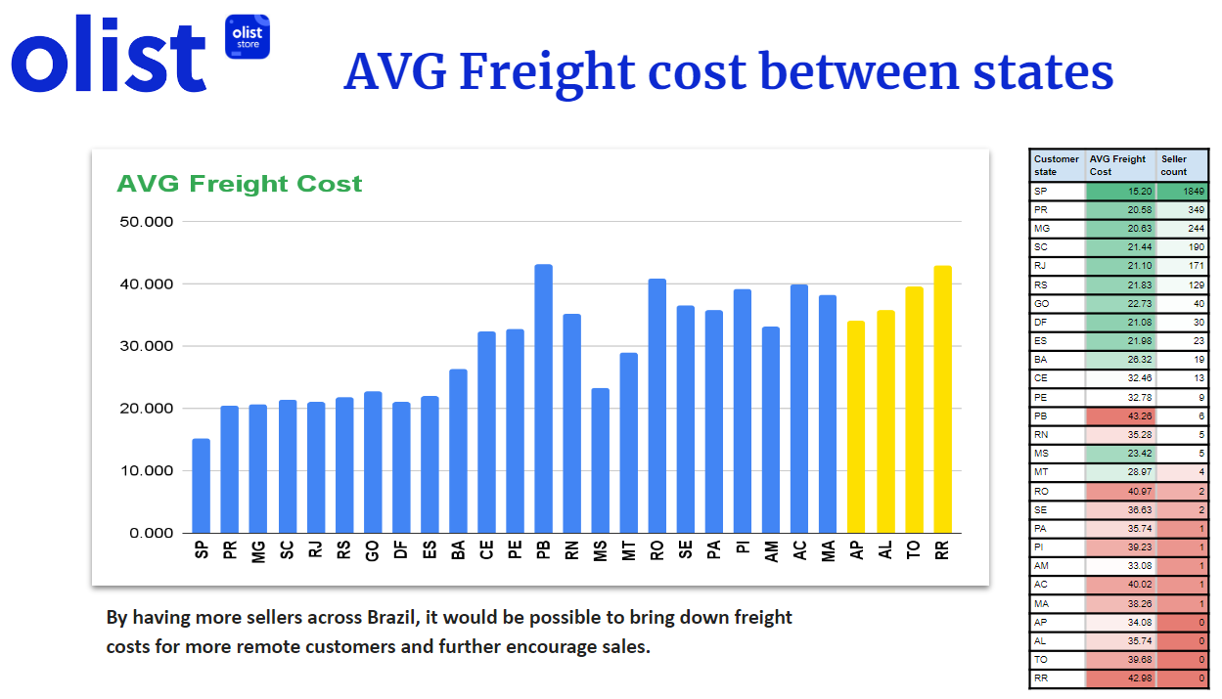
Situation Based Projects
Payments/Monetization Analysis
Task:
Identify different aspects of the business. Create presentation around the insights.
Click here to access the project

Slide 10
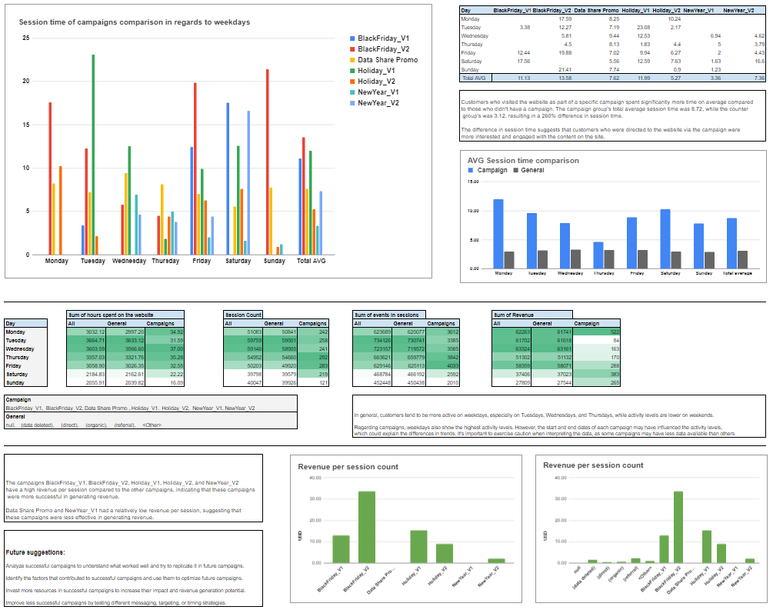
Situation Based Projects
Marketing Analysis
Task:
To find out if users tend to spend more time on website on certain weekdays and how that behavior differs across campaigns.
Click here to access the project
SQL code

